Slide 1
Upgrading your Brain
Pragmatic Thinking & Learning
Drew Shefman
dshefman@squaredi.com
http://squaredi.blogspot.com

Slide 2
What are you talking about today
Journey from Novice to Expert
How an expert brain works
Upgrading your Brain

Slide 3
Your take-aways
Identifying the stages of the Dreyfus Learning Model
Understanding how the brain processes information
Ability to enhance that processing procedure

Slide 4
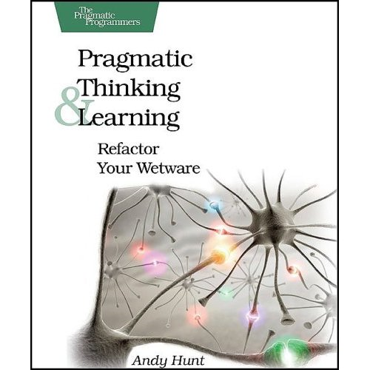
More Info: Book
Pragmatic Thinking & Learning: Refactor your Wetware
By Andy Hunt

Slide 5
Dreyfus Learning Model for Skill Acquisition
Stage 1 ( Novice )
Stage 2 ( advanced Beginner )
Stage 3 ( Competent )
Stage 4 ( Proficient )
Stage 5 ( Expert )

Slide 6
Novice – Stage 1
Just want to get it done
Confused when things don’t work
Need specific rules and recipes
No real understanding of context
Focuses on “features”

Slide 7
Advanced Beginner – Stage 2
Can begin to break away from the rules
Difficulty trouble shooting
Limited understanding of context – no big picture
Wants information fast.
Does not feel responsible
Focuses on “situations”

Slide 8
Competent – Stage 3
Conceptual models
Can troubleshoot
Can solve new problems
Seeks out and uses advice
May not know what to focus on when troubleshooting
“Has initiative”, “resourceful”, “responsible”
Focuses on “aspects”

Slide 9
Proficient – Stage 4
Requires the big picture
Self reflection and self improvement
Can learn from other’s experience
Know when rules apply and don’t apply
Focuses on “perspectives”

Slide 10
Expert – Stage 5
Source of knowledge
Actively and constantly trying to improve
Works mainly from intuition
Can focus on what details are important and relevant and knows what can be ignored
Often can’t articulate an explanation, only that something “seems right” or “doesn’t seem right”

Slide 11
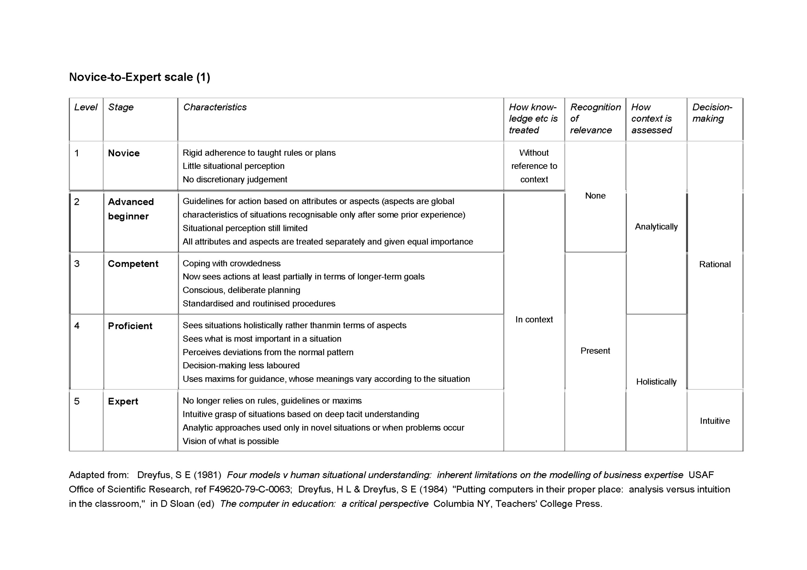

Slide 12
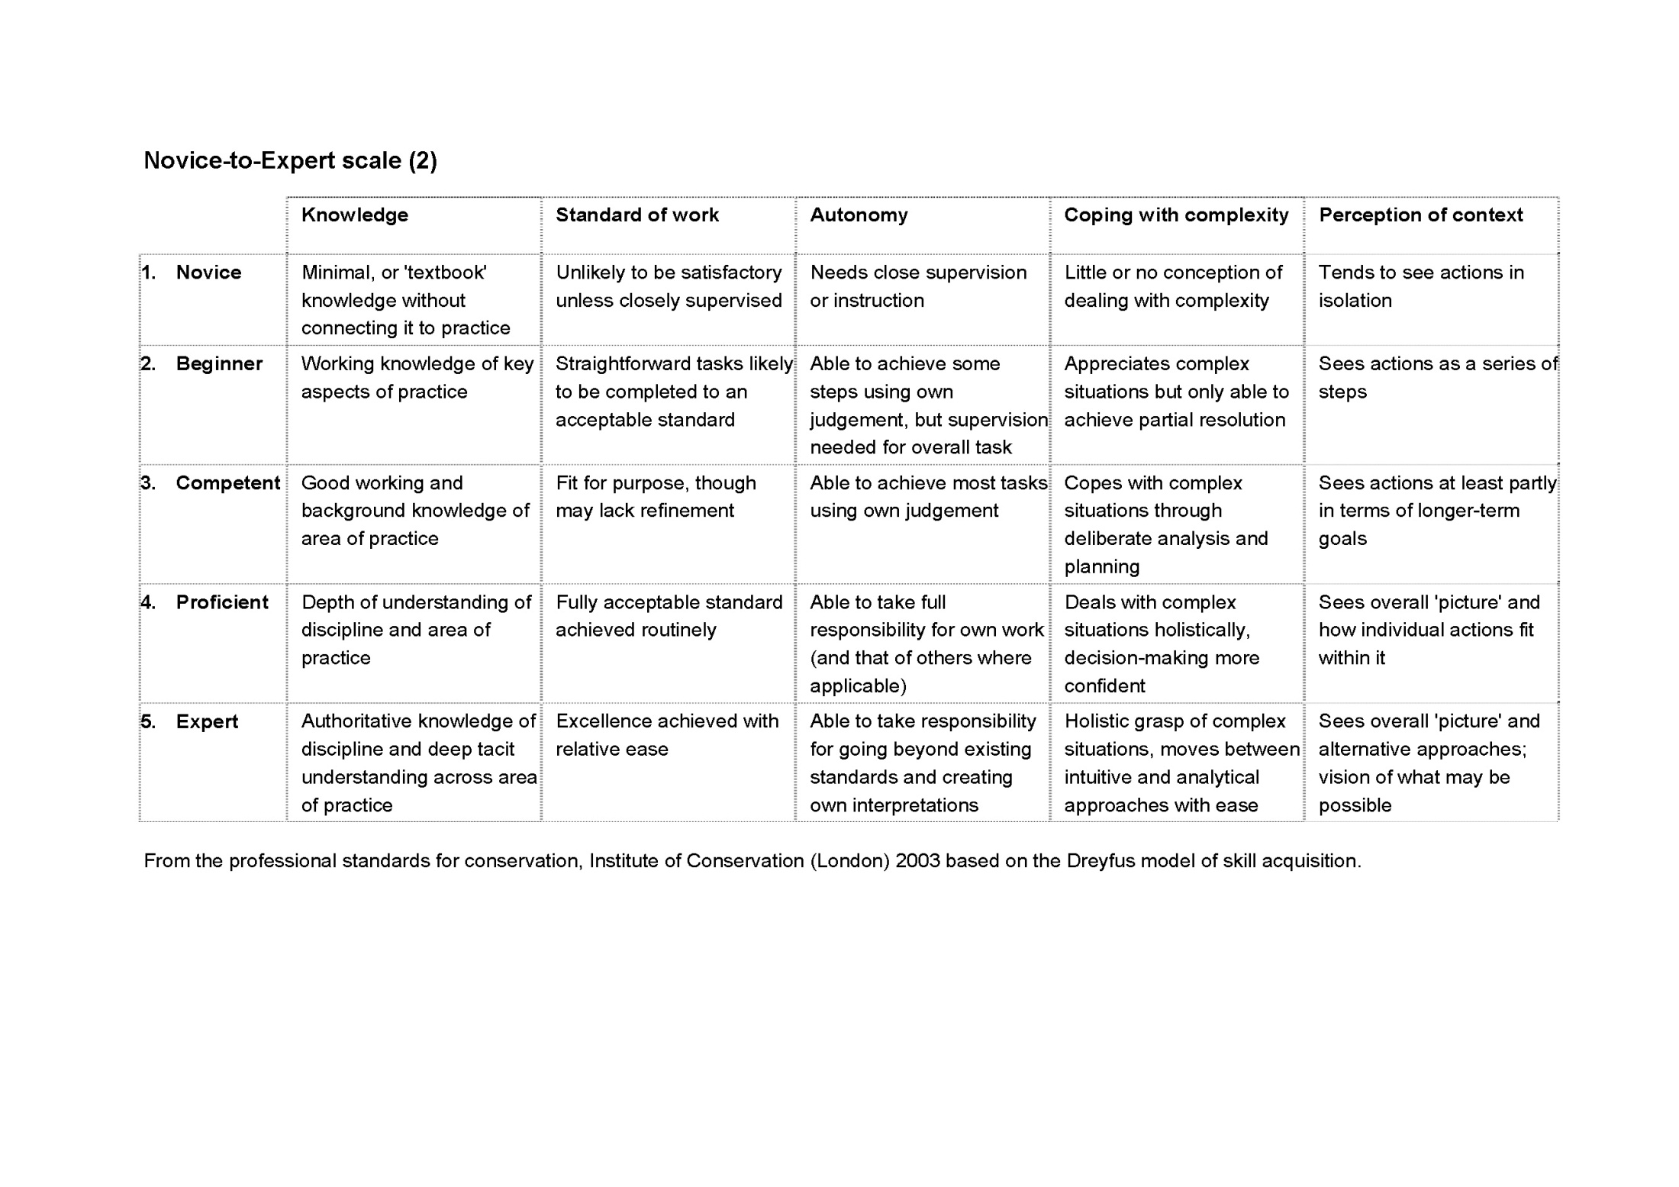

Slide 13
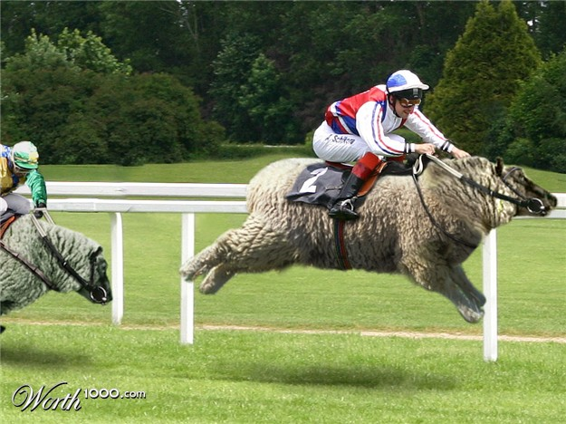
The Bad News
Herding Racehorses and Racing Sheep

Slide 14
Becoming an Expert
Takes about 10 years to become an expert
No shortcuts
Constant learning and practice required
Only applies to a single skill

Slide 15
Expertise as a single skill
Likely we are all experts at walking, but we might not be experts at cooking.
Can you explain how you walk to a novice?
Actually, imposing rules on an expert significantly DECREASES performance.

Slide 16
Walking explained by an expert
Strike the ground first with your heel
Roll through the step from heel to toe
Push off with your toe
*About.com

Slide 17
Walking explanation needed for a novice
Stand in an upright position with the feet together and the weight held slightly forward towards the ball of the feet.
Swing the leg forward from the hip with the ball of the foot in contact with the floor then with the heel lightly skimming the floor with the toe slightly raised.
As soon as the front heel moves past the back toe, the back heel will be released from the floor and at the extent of the stride the weight will be equally divided between the heel of the front foot and the ball of the back foot with the front knee bent and the back knee slightly flexed.
The front toe will then immediately lower as the weight of the body moves forward.
The back foot commences to move forward with first the toe, then the ball of foot skimming the floor until the feet are level and the back foot then continues forward into the next step.
Try walking this way for yourself,
be careful not to fall!
*International Society for Teachers of Dance

Slide 18
Novice reactions
Novices will feel frustrated and flustered if not given enough direction.
Example: Dancing International Foxtrot*
Step forward with the left foot for slow
Step forward with the right foot for quick
Step forward with the left foot for quick
Repeat
How does this set of directions make you feel?
*I’m assuming most of my audience is novice at this

Slide 19
Other disappointing information
Most adults, regarding most skills, for most of their lives are ADVANCED BEGINNERS (Stage 2)
It is a bottom weighted curve, not a standard deviation
The ability to be self-aware enough to categorize yourself correctly doesn’t happen until Stage 4
Most companies expect that after training a novice for a week, that they are now competent or proficient

Slide 20
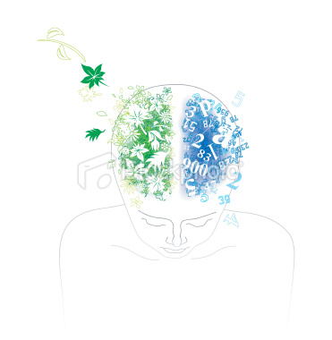
This is your brain
Linear Mode (L-Mode)
and
Rich Mode (R-Mode)

Slide 21
Your Brain as a Computer
Dual CPU
1st CPU (L-Mode) – Linear, slow
2nd CPU (R-Mode) – multicore, asynchronous, fast
Shared bus to memories

Slide 22
L-mode
Verbal – describes, names, defines
Analytic – step-by-step
Symbolic – symbols can stand for something else
Abstraction – the part represents the whole
Temporal – sequencing and time tracking
Rational - draws conclusions based on facts
Digital – numbers and counting
Logical – draws conclusions based on theorems
Linear – linked ideas
Consciously controllable

Slide 23
R-mode
Non-Verbal – images and music
Non-Rational –creativity
Synthetic - creating
Spatial – 3d organization of shapes
Analogical – Spectrum of answers
Holistic
Non-Linear
INTUITIVE – (The hallmark of an EXPERT!)
Subconsciously controlled

Slide 24
Getting in your Right Mind
Tips for getting R-Mode working

Slide 25
DIY Brain Surgery
THINKING that your brain has more capactiy, makes it so. (Neuroplasticity)
Skills and abilities that you constantly use and constantly practice, dominate. (Cortical competition)

Slide 26
Engaging the R-Mode
Shut down L-mode chatter: Listen to music, draw, doodle, exercise
Add additional sensory input while learning / problem solving
Write drunk, revise sober
Journal, blog, free form write, mind maps

Slide 27
Intuition is great, but is often wrong
Cognitive biases : How your thinking can be led astray
Generational affinity: How your peers can influence you
Personality tendencies: How your personality influences your thoughts
Hardware bugs: Older portions of the brain can override smarter portions
Trust intuition – but verify

Slide 28
Learn Deliberately == SMART
Specific
Measurable
Achievable
Relevant
Time-boxed

Slide 29
Knowledge Portfolios & Investment Plans
Have a concrete SMART plan
Diversify
Active Investment
Invest Regularly

Slide 30
Gaining Experience
PLAY – engaging in an activity with no goal as to the outcome
Learn from similarities – UNLEARN from differences
FAIL often, but safely
OBSERVE – Don’t just do something, stand there

Slide 31
Next Steps
Just do it!
&
Read the book ☺

